Slide 1

🎓 GMC Education Portal
Digital Learning Platform for Government Schools
Transforming Education in Gandhinagar
Gandhinagar Municipal Corporation • February 2026

Slide 2

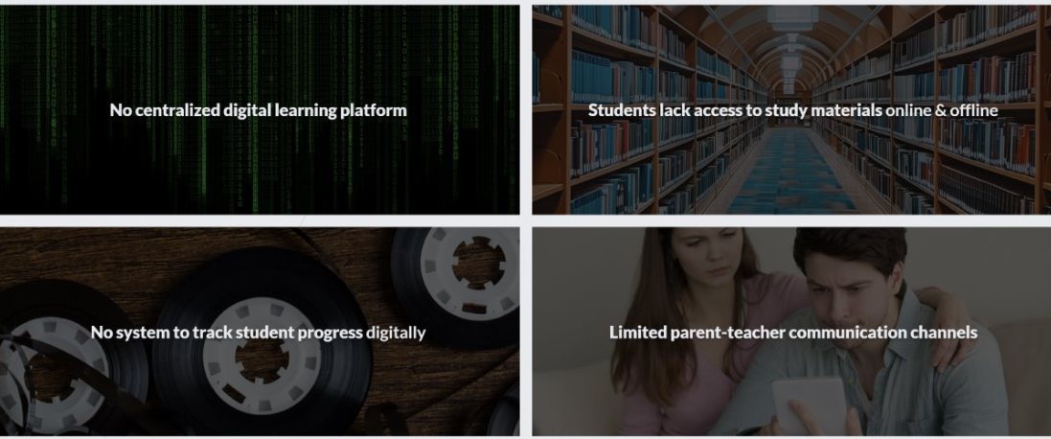
Current Challenges in GMC Schools

Slide 3
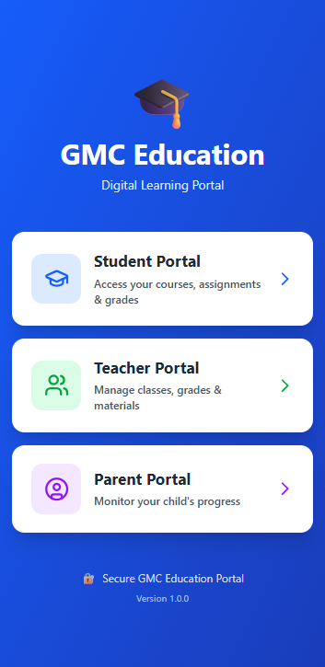
GMC Education Portal Solution
Complete digital ecosystem for schools
Digital library with NCERT textbooks (online & offline)
Assignment submission & tracking system
Student progress dashboard with analytics
Parent access portal for monitoring

Slide 4
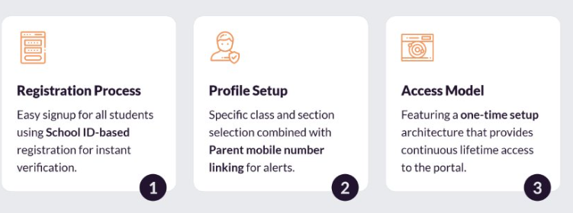
Step 1: Student Registration

Slide 5
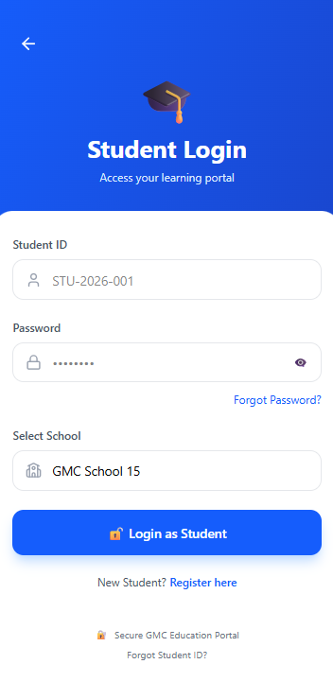
Student Login Interface
Simple and secure access
Student ID login
Password authentication
Select school and class

Slide 6
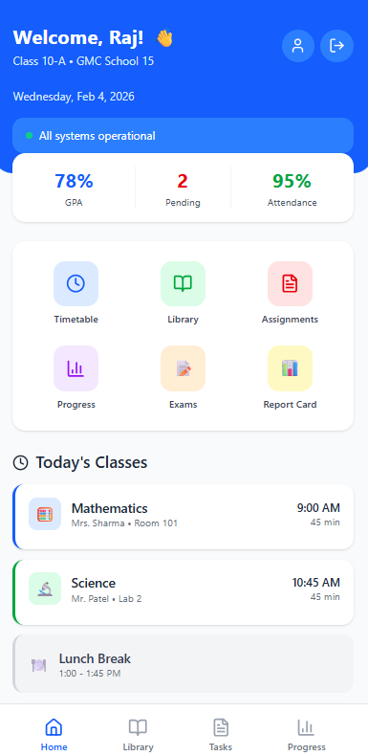
Step 2: Student Dashboard
Central hub for learning
Today's class schedule visible
Pending assignments highlighted
Quick access to study materials
School announcements displayed

Slide 7
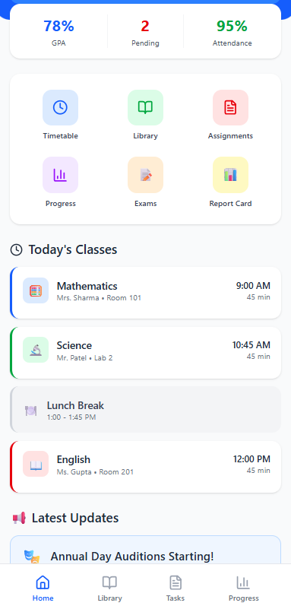
Dashboard Mobile View
All learning tools in one place
Today's schedule overview
Pending homework alerts
Recent announcements

Slide 8
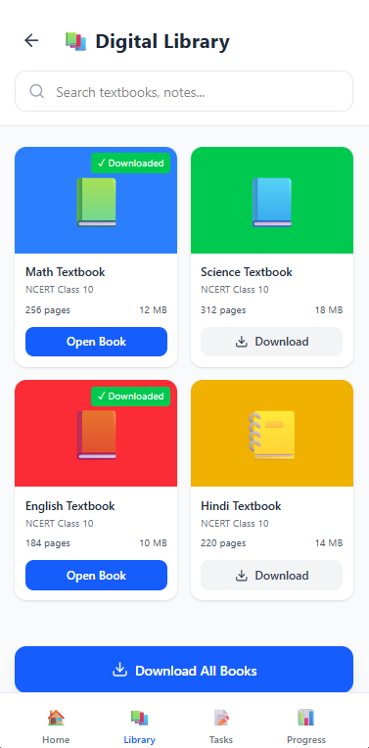
Step 3: Digital Library
Access study materials online & offline
NCERT textbooks for all subjects
Download for offline reading
Previous year question papers
Reference books and guides

Slide 9
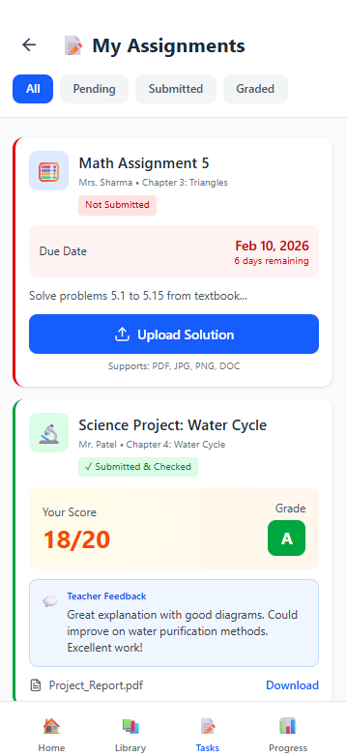
Step 4: Assignment Submission
Digital homework system
View assignments with due dates
Upload answers as PDF or images
Get marks and feedback from teachers
Track submission status

Slide 10
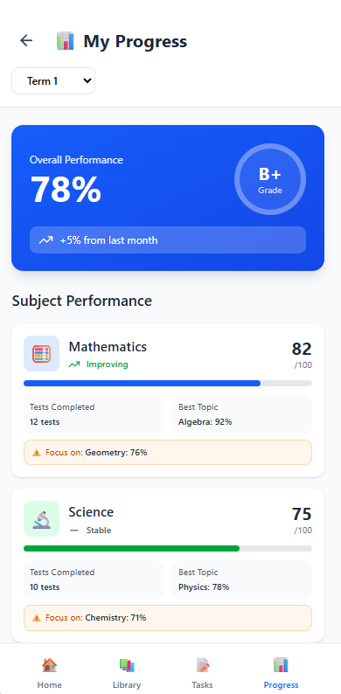
Step 5: Progress Tracking
Monitor student performance
Subject-wise marks displayed
Attendance percentage tracking
Performance graphs and analytics
Strengths and improvement areas identified

Slide 11
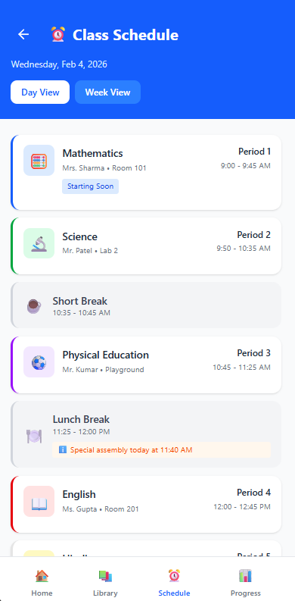
Daily Class Timetable
Weekly schedule at a glance
Period-wise daily schedule
Subject and teacher information
Special classes and activities marked
Offline access to timetable

Slide 12
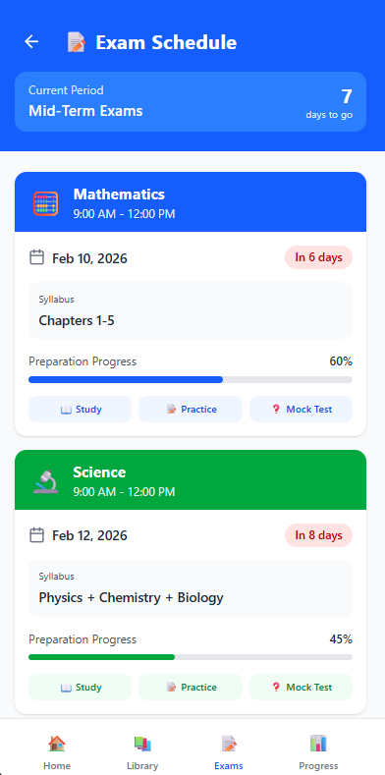
Examination Timetable
Exam schedule management
Subject-wise exam dates visible
Exam timing and duration details
Syllabus for each exam listed
Preparation countdown timer

Slide 13
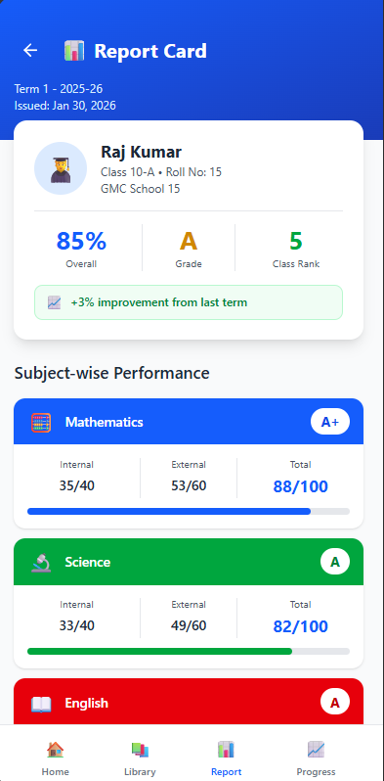
Digital Report Card
Complete exam results
Subject-wise marks and grades
Overall percentage and rank
Teacher remarks and feedback
Download PDF report card

Slide 14
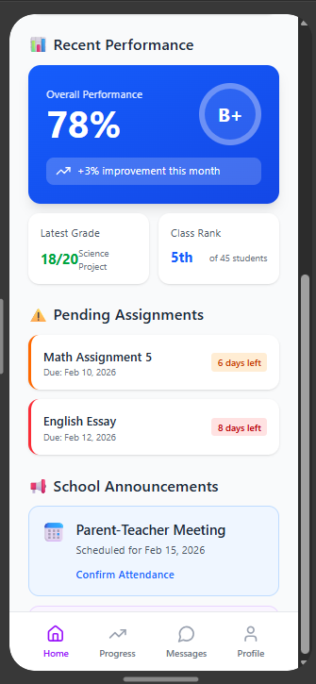
School Announcements
Stay updated with school news
Exam date notifications
Holiday announcements
Event and competition updates
Important circular notifications

Slide 15
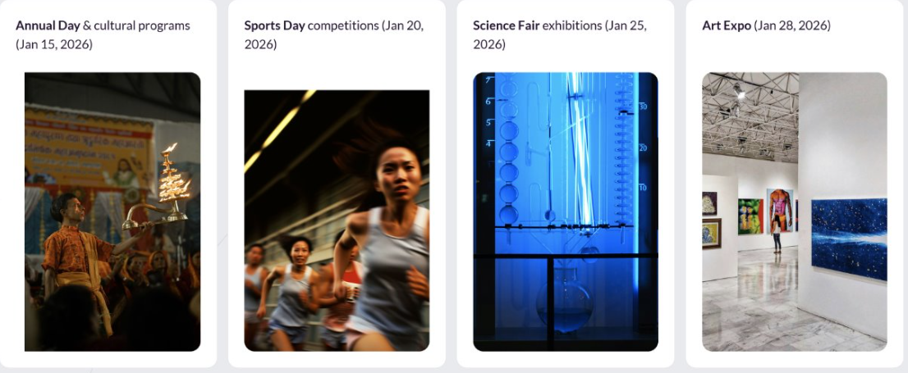
School Photo Gallery
View school events and activities

Slide 16
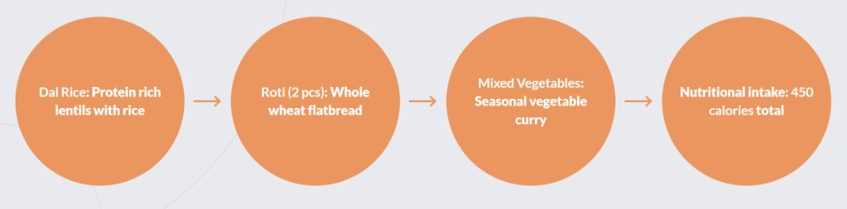
Daily Meal Menu
Mid-day meal tracking system

Slide 17
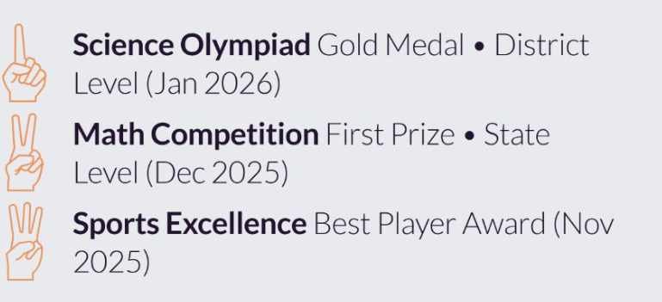
Student Achievements
Showcase awards and certificates

Slide 18
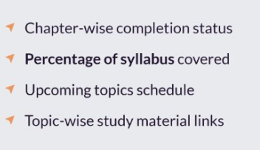
Syllabus Coverage Tracker
Monitor curriculum progress

Slide 19
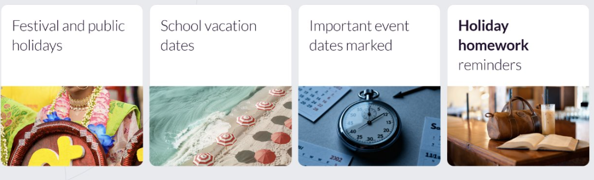
Holiday Calendar
Annual holiday schedule

Slide 20
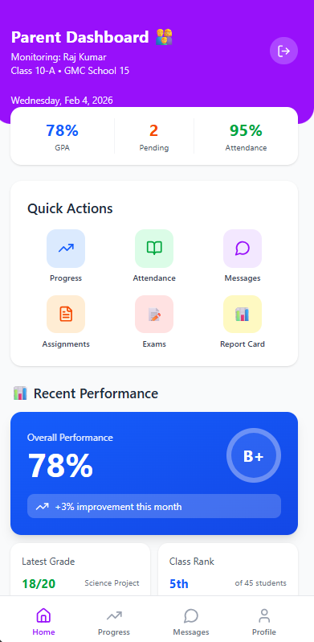
Parent Access Portal
Keep parents informed and engaged
View child's attendance and marks
SMS alerts for important updates
Direct communication with teachers
Monitor homework completion

Slide 21
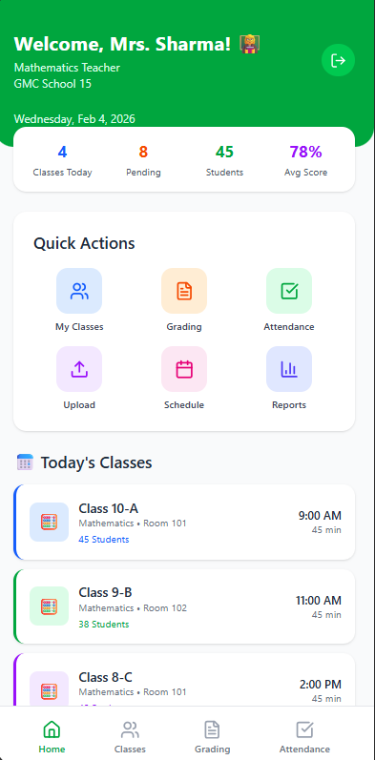
Teacher Dashboard Features
Upload study materials and notes
Create and grade assignments
Track student attendance digitally
Generate progress reports

Slide 22
Exam Preparation Resources
Get ready for board exams
Practice tests with timer
Previous year board papers
Sample papers with solutions
Chapter-wise revision notes

Slide 23
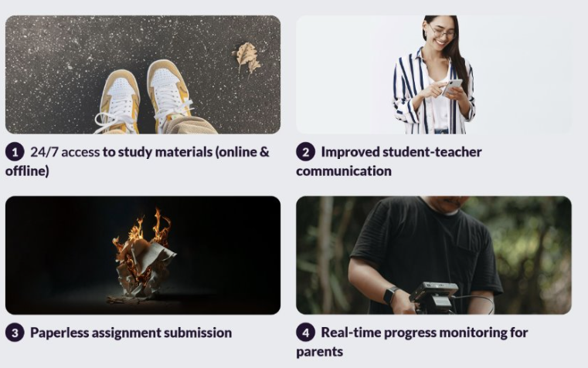
Platform Impact

Slide 24

Thank You! 🙏
GMC Education Portal
Empowering Students Through Digital Learning

